Slide 1

P peline
The Data
Data Quality
© Jennifer Mankoff & Nikola Banovic
The Data Pipeline; HCII; Spring 2017

Slide 2
Goals
After this, you should be able to:
Describe the four Cs of data quality
Explain causes of quality issues for each of them
Explain fixes for quality issues for each of them
Adapted from http://www.fordham.edu/economics/Vinod/correl-regr.ppt

Slide 3
Recommended Reading
The Bad Data Handbook (McCallum): O’Reilly Press
Making Sense of Data: A practical guide to Exploratory Data Analysis and Data Mining
Tukey: Exploratory Data Analysis

Slide 4
Four C’s of Data Quality
Is your data Complete?
Is your data Coherent?
Is your data Correct?
Is your data aCcountable?

Slide 5
Questions about Completeness
Appropriate Data: Does the data you have match the questions you want to answer?
Missing Data: Data does not exist because it was never obtained or was lost
Reporting error: The sensor (or respondent) is reporting junk values

Slide 6
Solutions and Issues for Appropriate Data
Look ahead … to the questions you’d like to answer
Reason back … to the data you’d need to collect

Slide 7
Solutions and Issues for Missing Data
Impute the data using statistics
Find an alternative source
Reweight the data to reflect the changed sample

Slide 8
Solutions and Issues for Reporting Errors
Finding the error:
May collect the data twice and compare
Find an alternative source to compare
Can you look for sources of bias across variables (surveys with only round values; people who report everything in round numbers)
How does the way you collect data affect reporting errors?
Assessing its impact:
Is it random or does it introduce bias
Is it more likely in some variables than others

Slide 9
Is your Data Coherent?
Does the data “add up”?
Does it make sense relative to itself?
Examples
Non number in a numeric field
Month field has something other than a month
Email has no @
Hourly data adds up to 24 hrs per day
Etc.

Slide 10
Nominal/Ordinal Field Data Inspection
How many are there?
Are they spelled consistently?
What is the frequency distribution of different values?

Slide 11
Interval/Ratio Field Data Inspection
Calculate min/max/mean; Make graphs!
- are there unexpected negative values? Very large targets/long motions/low velocity?
What outliers do you have?
- could represent measurement errors
- could be genuine
Do you have unexpected patterns
- can you see unexpected patterns when you visually inspect your data?
Notes:
Need domain expertise to differentiate!

Slide 12
How do we address extreme values?
Outlier Treatment
Can drop them
Winsorization (replace with a less extreme value)
Replace them with a default.
De-Duplication
Domain-based adjustments

Slide 13
How to detect and quantify skew?
A vector denoting presence/absence/percentage of data in each entity (location/person) ➔ glitch signature
Outlier detection techniques
Summary statistics
Graphs and Charts
Notes:
A value dij ∈ D is “clean” if and only if every value in vij is zero, that is the sum of the bits is 0. Glitch signatures can be considered augmented or derived data that enable us to flag glitches, quantify their prevalence, and identify patterns in an analytic, automated fashion.

Slide 14
Did we improve things?
Compare glitch index (sum of glitch signature) before and after
Check for statistical distortion (measure the distance from D to D*

Slide 15
Is your data Correct?
Is there a sources of bias?
Within the population (Sample Bias)
Across variables (e.g. surveys with only round values; people who report everything in round numbers)
Example Types of Problems
Measurement Errors: [variable level]
Fraudulent Data
Implementation Issues [algorithms]

Slide 16
Quantifying Impact
Are errors random or do they introduce bias?
Are errors more likely in some variables than others?
Is there a specific type of error you expect?
Can you go to the source and ask about error?

Slide 17
Is your data Correct?
Is there a sources of bias?
Within the population (Sample Bias)
Across variables (e.g. surveys with only round values; people who report everything in round numbers)
Example Types of Problems
Measurement Errors: [variable level]
Fraudulent Data
Implementation Issues [algorithms]

Slide 18
Survey
How many hours of sleep did you get last night?
https://goo.gl/forms/UTYJdWMvO5X7OxDl1
Content borrowed from Bill Thies

Slide 19
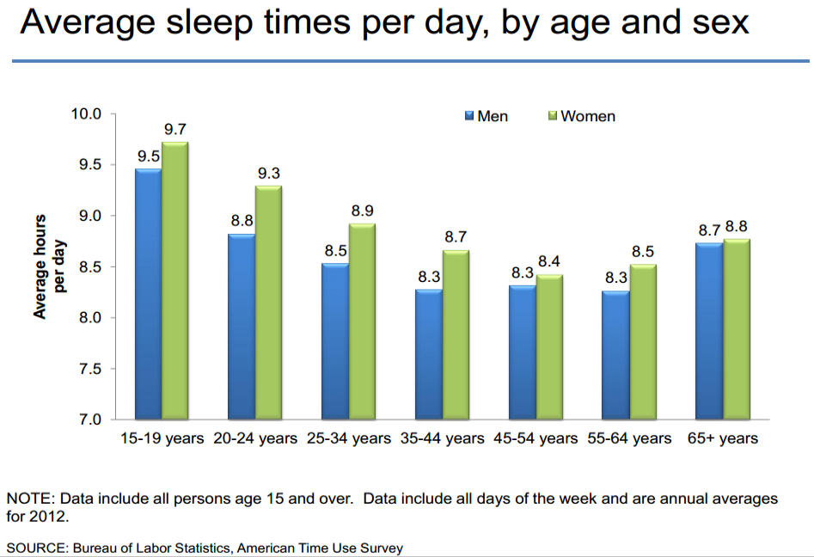
Notes:
Xx

Slide 20
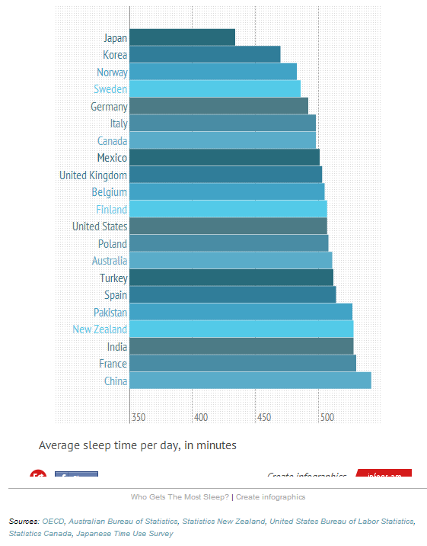
Notes:
Xx http://graphics.wsj.com/how-we-sleep/ add this in to discussion

Slide 21
Solutions and Issues for Sample Selection
Finding the error:
How was the data collected?
Who was included?
How were they selected?
Addressing its impact:
If it is your sample, pay careful attention to how you select participants
Is it random or does it introduce bias?
Is it more likely in some variables than others?
Is there a specific type of error you expect?

Slide 22
Is your data Correct?
Is there a sources of bias?
Within the population (Sample Bias)
Across variables (e.g. surveys with only round values; people who report everything in round numbers)
Example Types of Problems
Measurement Errors: [variable level]
Fraudulent Data
Implementation Issues [algorithms]

Slide 23
Measurement Errors
Badly Designed Questions
Double barreled (two in one)
Leading; Response ‘primed’
Intrusive
Answer impossible to recall
Skipped Question & ‘No’ indistinguishable
No correct category
Ambiguous
Inconsistent terminology

Slide 24
Example
"Please agree or disagree with the following statement: Cars should be faster and safer."
Thank you Wikipedia.
Notes:
https://www.usablestats.com/calcs/2samplet&summary=1

Slide 25
Illusory superiority
A cognitive bias that causes people to overestimate their positive qualities and abilities and to underestimate their negative qualities, relative to others
Also known as:
above average effect
superiority bias
leniency error
sense of relative superiority
Content borrowed from Bill Thies

Slide 26
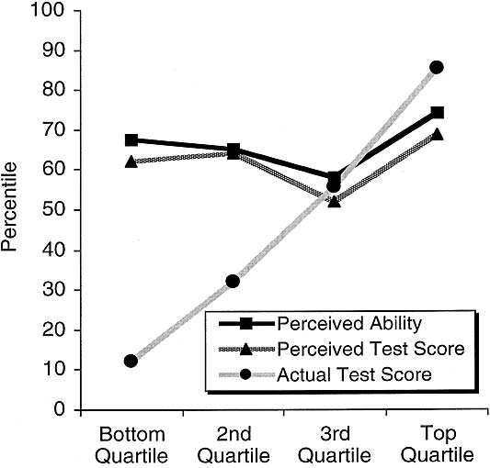
Replicated in many domains
“participants in the bottom quartile not only overestimated themselves but believed that they were above average.”
Figure 2: Perceived logical reasoning ability … from gagne.homedns.org/~tgagne/contrib/unskilled.html#fig2
Notes:
The authors went on to demonstrate that ‘deficits in metacognitive skills mediate the link between low objective performance and inflated ability assessment’… also see file:///Users/jmankoff/Downloads/incompetence.pdf

Slide 27
Also evidenced in studies of:
Memory
Cognitive tasks
Academic and job performance
Health
Popularity
Stock market trading
Taking lawsuits to trial
Content borrowed from Bill Thies

Slide 28
Measurement Errors
Badly Designed Questions
Badly Chosen Sensors
Invasive (may be turned off or covered up)
Incomplete (miss a large portion of the activity of interest)
Wrong level of detail

Slide 29
Measurement Errors
Badly Designed Questions
Badly Chosen Sensors
Bad Administration of Measurement Instrument
Long or badly formatted questionnaire
Non-objective collector/Non blinding
Respondent learning
Cultural Issues
Bad placement of sensor

Slide 30
Measurement Error Experiment: Eye Witness Report
Count off;
https://goo.gl/forms/qZkl0fzzOgzcOVYE2
https://goo.gl/forms/8XAFz2IbMDgmoH8k2
Content borrowed from Bill Thies

Slide 31
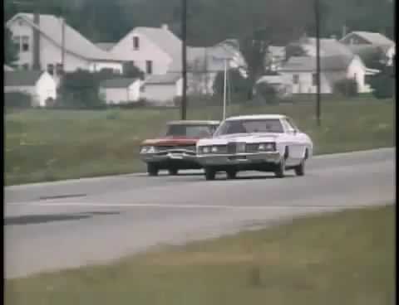
Content borrowed from Bill Thies

Slide 32
Answer the survey on your sheet
Content borrowed from Bill Thies

Slide 33
There were Two Versions of the Survey (Loftus & Palmer, 1974)
About how fast were the cars going when they contacted each other?
About how fast were the cars going when they smashed into each other?
Content Borrowed from Bill Thies

Slide 34
Speed estimate by verb condition
Loftus and Palmer (1974)
Condition Speed Estimate (mph)
smashed 40.8
collided 39.3
bumped 38.1
hit 34.0
contacted 31.8
WHY?
Credit: Jones, Lauwereyns, Wilshire, Victoria University of Wellington

Slide 35
One week later… Did you see any broken glass?
Loftus and Palmer (1974)
Proportion of Ps giving a “yes” response.
Credit: Jones, Lauwereyns, Wilshire, Victoria University of Wellington

Slide 36
One week later… Did you see any broken glass?
Loftus and Palmer (1974)
Proportion of Ps giving a “yes” response.
Condition “Yes” saw broken glass
smashed .32
hit .14
control .12 [no speed estimate]
Verb influenced not only speed estimates but memory for details of the event. False memory for broken glass.
Credit: Jones, Lauwereyns, Wilshire, Victoria University of Wellington

Slide 37
Demand Characteristics
An experimental artifact where participants form an interpretation of the experiment's purpose and unconsciously change their behavior to fit that interpretation
Content borrowed from Bill Thies

Slide 38
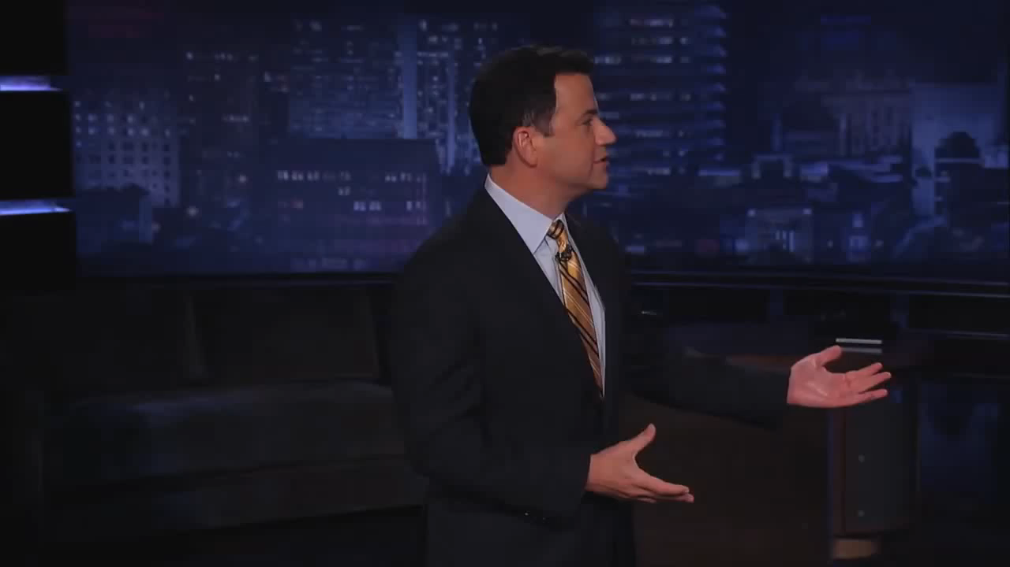
Content borrowed from Bill Thies

Slide 39
What can we do to minimize demand characteristics in HCI?
Be aware that response bias affects all studies
Dissociate from a particular design or solution
Minimize the differences in social status between investigators and participants
Use triangulation to validate data collected
Tricks for asking sensitive questions
Content borrowed from Bill Thies
41
Notes:
And lastly, use triangulation and alternative methodologies to validate any data collected. Avoid collecting subjective data. But be aware that quantitative data can also be affected.
Usage statistics and user performance can be affected as well.

Slide 40
Measurement Errors
Badly Designed Questions
Badly Chosen Sensors
Bad Administration of Measurement Instrument
Inaccurate Measurements
Regression to the mean [ideally need a control grp]
‘end aversion’
High sensor error
Notes:
http://en.wikipedia.org/wiki/Regression_toward_the_mean

Slide 41
Is your data Correct?
Is there a sources of bias?
Within the population (Sample Bias)
Across variables (e.g. surveys with only round values; people who report everything in round numbers)
Example Types of Problems
Measurement Errors: [variable level]
Fraudulent Data
Implementation Issues [algorithms]

Slide 42
Proxy Reporting
Finding the error:
Mainly an issue in surveys where the respondent may not be who you think.
Sometimes intentional when your sensor breaks down, etc.
Addressing its impact:
Is it random or does it introduce bias
Is it more likely in some variables than others
Is there a specific type of error you expect?
Can you ask people in surveys if they are doing it?

Slide 43
Curbstoning is a common threat to data quality.
Curbstoning – when survey interviewers fabricate some or all of their data.
Why could it happen?
Difficult-to-reach households
Embarrassing or uncomfortable questions
Incentive structures
In one survey, 13% of interviewers fabricated at least part of their interviews, despite close supervision.¹
An “epidemic” of curbstoning almost derailed an epidemiological study.²
¹Kiecker and Nelson, 1996
²Turner et al., 2002
Slide Credit: Benjamin Birnbaum, University of Washington
Notes:
Survey practitioners call this fabrication of data “curbstoning”. This name comes from the idea that instead of actually interviewing people, the interviewers are sitting on the curb, outside the house, making up data.
*There are a number of reasons that interviewers might fabricate data.
Maybe certain households are really difficult to reach. Or maybe some questions are uncomfortable to ask, such as questions about HIV, drug use, or other taboo subjects. Or maybe the incentive structures of the survey make it tempting to commit outright fraud because you’re paid based on the number of interviews that you do.
So how often does curbstoning happen? Hard statistics are hard to come by, but there are a few examples of studies that measure the prevalence of curbstoning.
*In one of these studies, it was found that 13% of interviewers fabricated at least part of their interviews, despite being in a closely supervised setting in a call center.
*In another study, researchers described what they called an “epidemic” of curbstoning that almost derailed their entire survey on drug use.
These are examples where researchers explicitly looked for curbstoning, but as you might imagine, it’s a problem in many surveys simply because it is faster and easier to fabricate data than to gather real data. I’ve talked to practitioners, and they say that they worry about the problem, they know that it happens, but it is often too difficult to and resource intensive to root it out.

Slide 44
Dealing with Curbstoning
Ask redundant questions and checks
Add other ways of monitoring data collection
Recently, some machine learning algorithms
Benjamin Birnbaum, U. Washington
(Algorithmic Approaches to Detecting Interviewer Fabrication in Surveys)
Anomaly detection in data + user interface trace
Achieves good results on simulated curbstone data

Slide 45
Legitimate hole filling
When data is not ‘your own’ you don’t always know where the values come from
Collector may have addressed ‘missing values’ in ways you may or may not agree with

Slide 46
Is your data Correct?
Is there a sources of bias?
Within the population (Sample Bias)
Across variables (e.g. surveys with only round values; people who report everything in round numbers)
Example Types of Problems
Measurement Errors: [variable level]
Fraudulent Data
Implementation Issues [algorithms]

Slide 47
Implementation Issues [algorithms]
Loss of precision
Badly chosen algorithms for intermediate data analysis (categorization, location id, etc)
Repeated data
…

Slide 48
Is your Data Accountable?
Do you understand the provenance of the data?
Have you protected any end users or other people who could be traced?
Can you back up your claims about the data?
Do you have the original data as well as any modifications (version control?)
Who has access to the data?

Slide 49
Summary: Steps So Far
Question
Is it the right question?
Collect Data
Is it the right data for the question?
How hard/easy is it to collect?
Clean Data
What flaws exist in the data?
Check and address the four Cs
Is it answerable?
Explore Data
Understand the fields
Use data

Slide 50
Things we talked about
Independent Samples & their meaning
Sampling errors (random & systematic bias)
How to address sampling errors (more data vs better data)

Slide 51
Things we talked about
Completeness: Missing data; Appropriate Data
Coherence: Relative to itself
Correctness: Relative to the world (within population and across variables)
Bias & other measurement errors (e.g. demand characteristics and illusory superiority)
Fraudulent data (e.g. curbstoning)
aCcountability

